Slide 1
Embedding Co-Assay Data in the Same Space
Presenter:
Songyang Cheng
Mentor:
Zakieh Tayyebi,
Dr. Christina Leslie

Slide 2
Data
https://www.ncbi.nlm.nih.gov/geo/query/acc.cgi?acc=GSE126074
GSE126074_AdBrainCortex, GSE126074_P0_BrainCortex
Chen S, Lake BB, Zhang K. High-throughput sequencing of the transcriptome and chromatin accessibility in the same cell. Nat Biotechnol 2019 Dec;37(12):1452-1457. PMID: 31611697

Slide 3

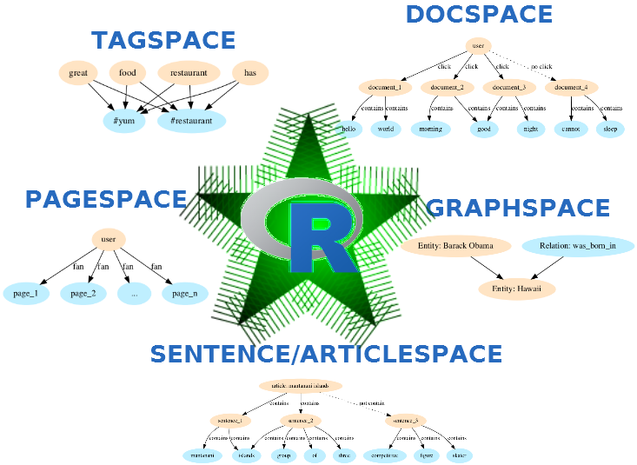
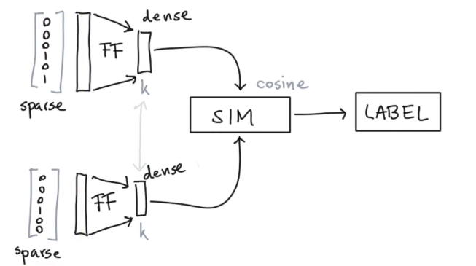
Underlying Natural Language Processing(NLP) Algorithm

Slide 4
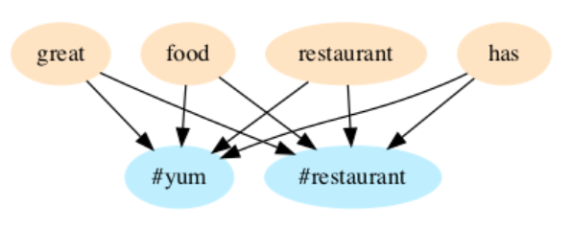
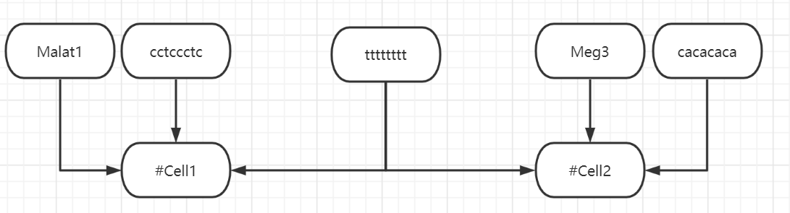
Tag Space

Slide 5
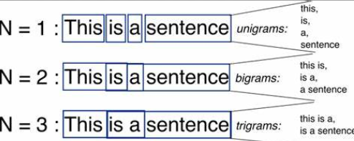
ngram

Slide 6
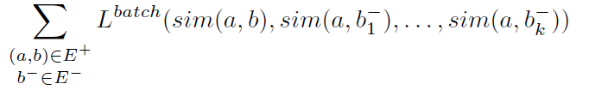
Loss Function
K negative sampling

Slide 7
Procedure
DNA:
run CellSpace to process sc-ATAC data output to dna.txt.
RNA:
process sc-RNA data and output to rna.txt.
Combined:
Concat rna.txt and dna.txt into one file merge.txt.
StarSpace:
Run StarSpace. Tuning Hyperparameters.
Downstream Analysis:
Clustering and pseudo-time analysis.

Slide 8
DNA (CellSpace)
Processed a barcode file containing cell names, a count matrix file containing cell*gene, and a peak file containing start and end positions for each peak in its chromosome.
#09I_TCCAACTCAGAG #09J_TACTTGGACACC #09E_CACTTGAAGTCT #09C_CCTCGATCGAGT #09J_AGGTTTGACCTC ttgccttc tgccttct gccttctg ccttctgc cttctgct ttctgctt tctgcttc ctgcttcg tgcttcgc gcttcgcc cttcgcct ttcgcctc tcgcctcc cgcctcca gcctccag cctccagc ctccagct tccagctt ccagcttc

Slide 9
RNA
Processed a barcode file containing cell names, a count matrix file containing cell*gene, and a file containing genes.
Lingo2:20 Lsamp:21 Dlg2:31 Celf2:32 Nrxn3:34 Lrrtm4:35 Kcnip4:41 Meg3:51 Ptprd:64 Malat1:205 #09A_CAGCCCCGCCTT
Notes:
The second part is to process rna data. We load the data as Seurat objects, and normalize this data. We sample genes for cells based on the counts and assign weights. If these genes are more expressed in certain cells, the weights are higher. In addition, the weights of genes are sorted in ascending orders.

Slide 10
Parameters for StarSpace
line.per.peak = 15 (dna)
fileword.per.line = 100 (rna)
line.per.cell = 30 (rna)
embedding = 15
ngrams = 5
similarity=“cosine”
lr = 0.2 (0.1 for RNA)
epoch = 100 (50 for RNA bc not going down any more)

Slide 11
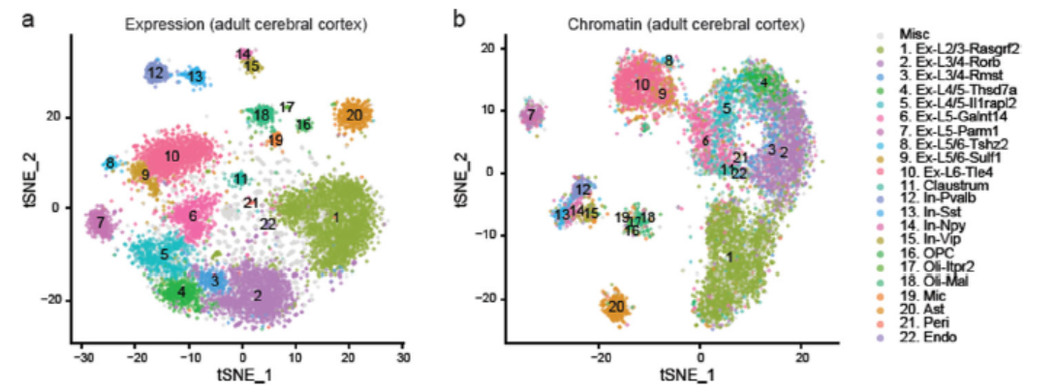
Ad data
In Prof. Chen’s paper: Peaks fewer than overall 5 counts or expressing in more than 10% of cells were removed

Slide 12
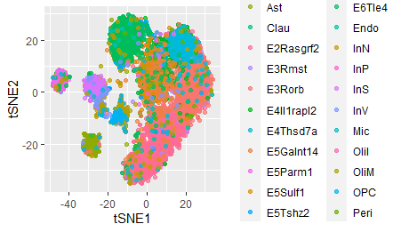
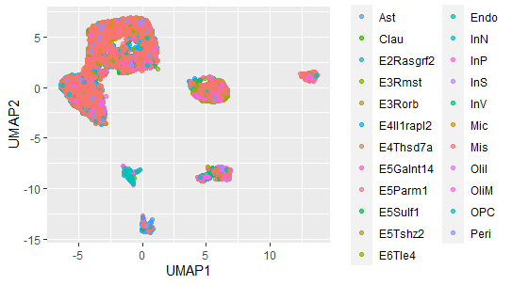
Reproduction for ATAC data

Slide 13
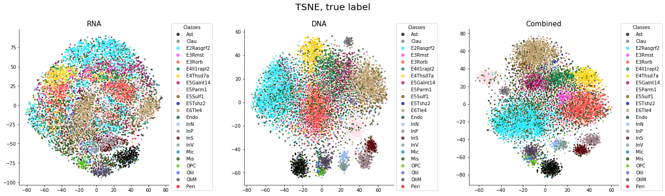
Embedding=15

Slide 14
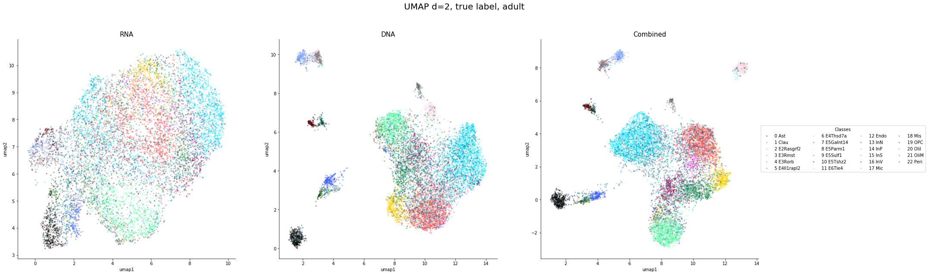

Slide 15
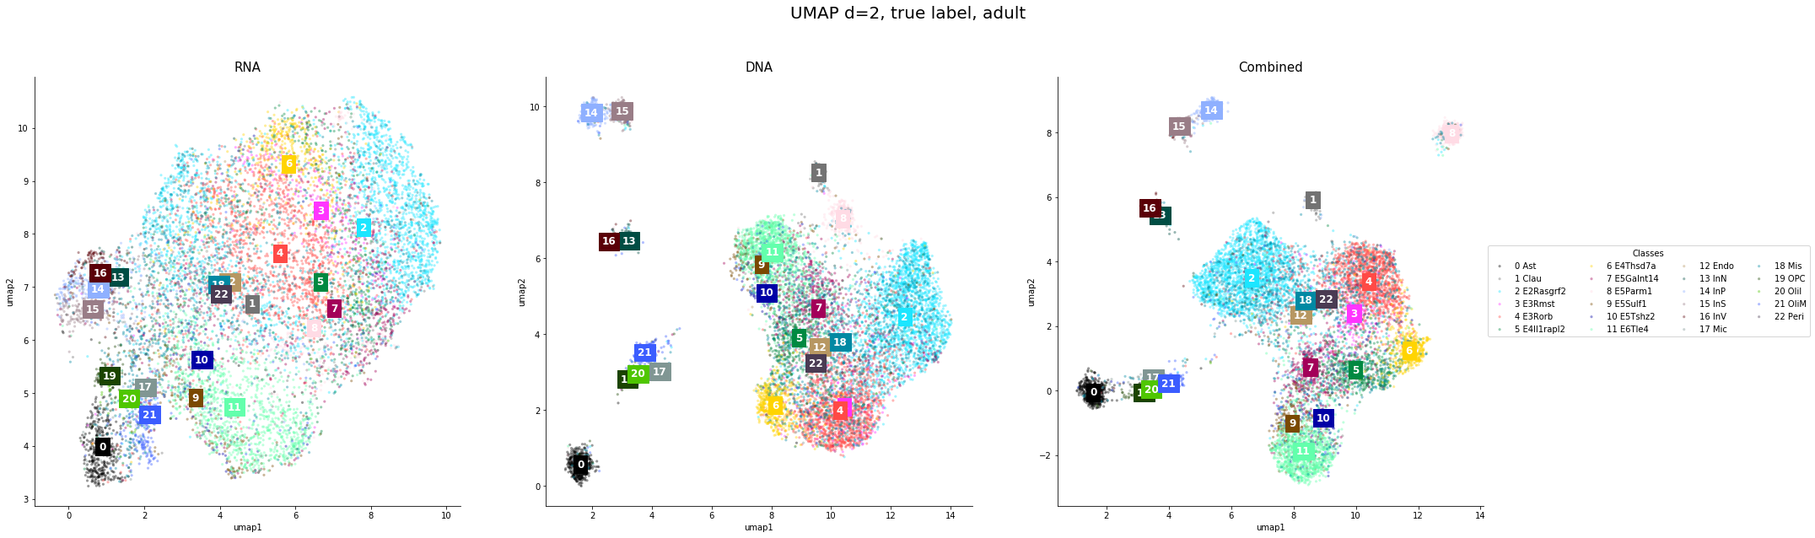
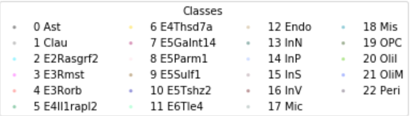

Slide 16
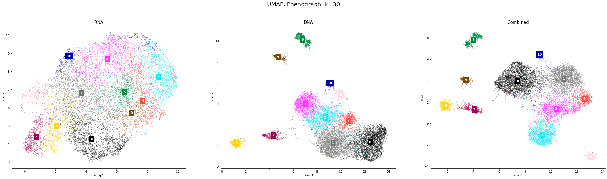
Downstream Analysis: Phenograph

Slide 17
AMI
Adjusted Mutual Information (AMI) is an adjustment of the Mutual Information (MI) score to account for chance.
This metric is independent of the absolute values of the labels: a permutation of the class or cluster label values won’t change the score value in any way.
AMI(U, V) = [MI(U, V) - E(MI(U, V))] / [avg(H(U), H(V)) - E(MI(U, V))]

Slide 18
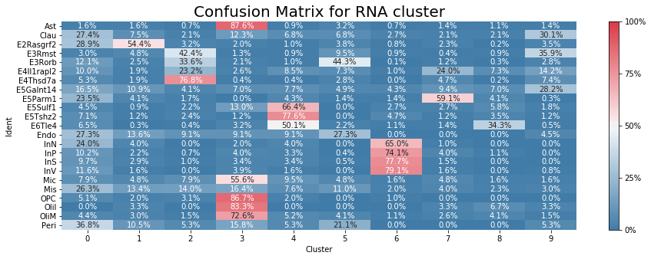
Phenograph: RNA
The AMI score is 0.3450832628991115

Slide 19
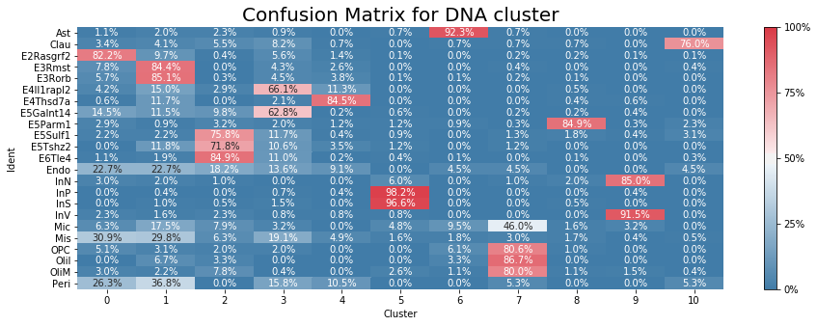
Phenograph: DNA
The AMI score is 0.5430087256846088

Slide 20
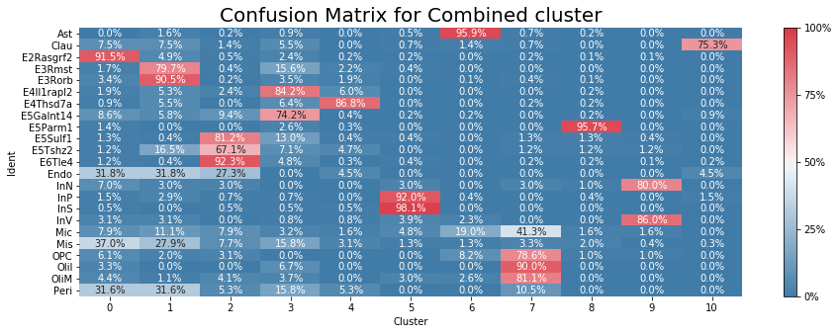
Phenograph: Merge
The AMI score is 0.6140321773957397

Slide 21
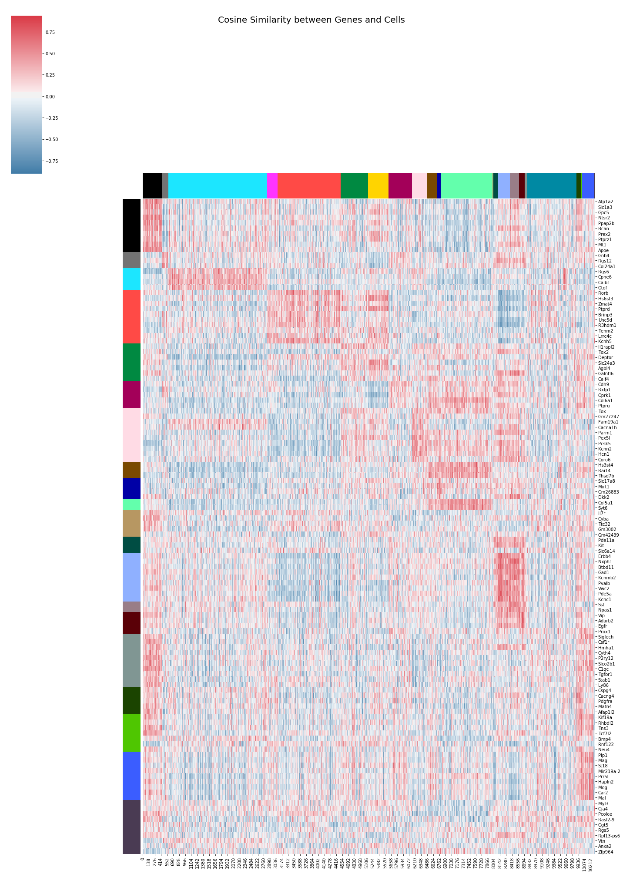

Slide 22
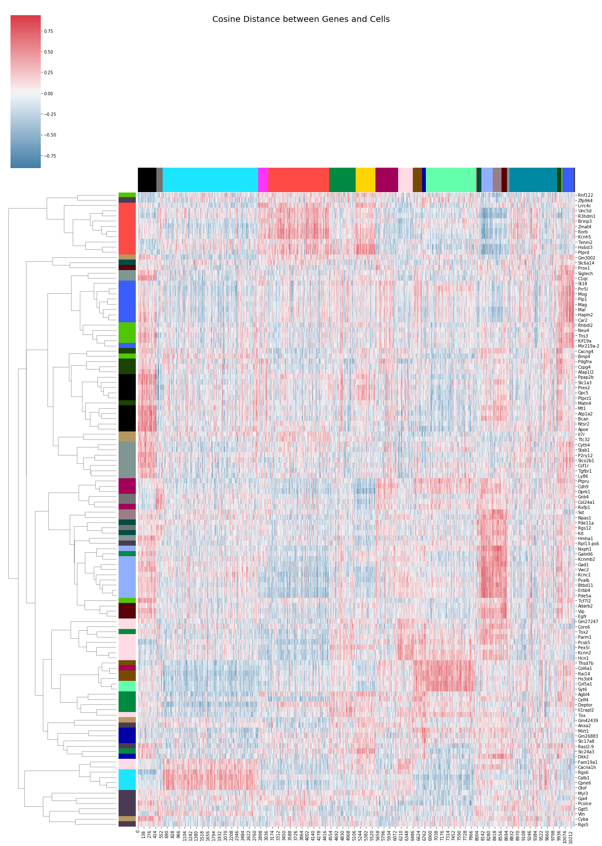

Slide 23
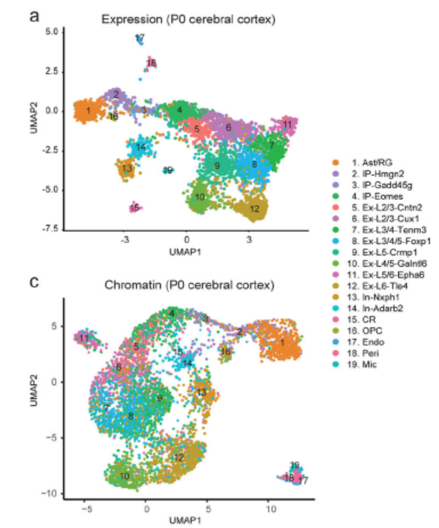
Neonatal (p0)

Slide 24
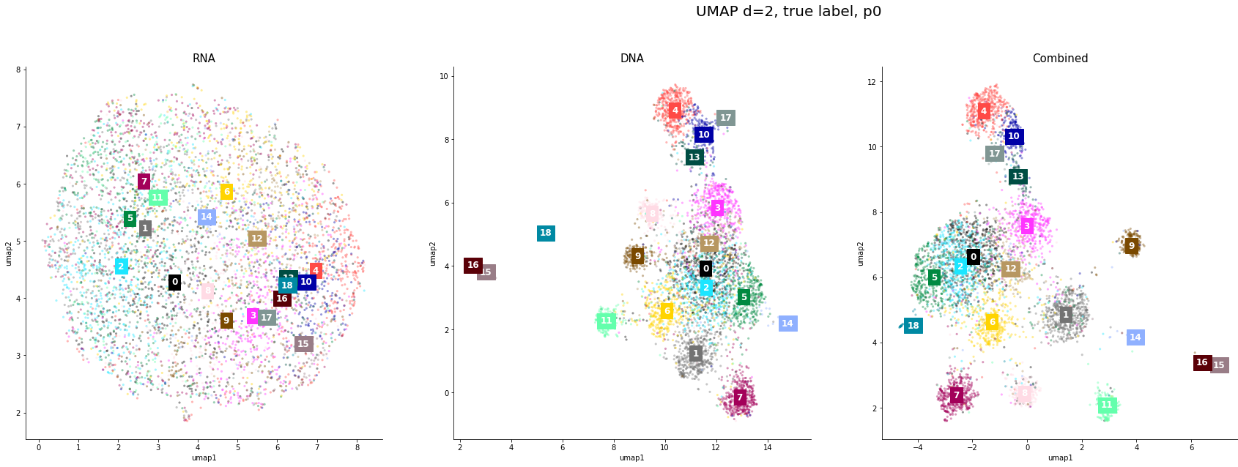
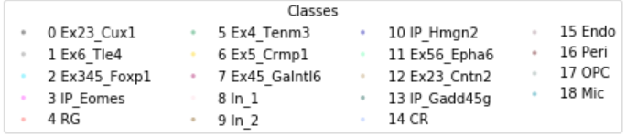
IP
IN
Ex

Slide 25
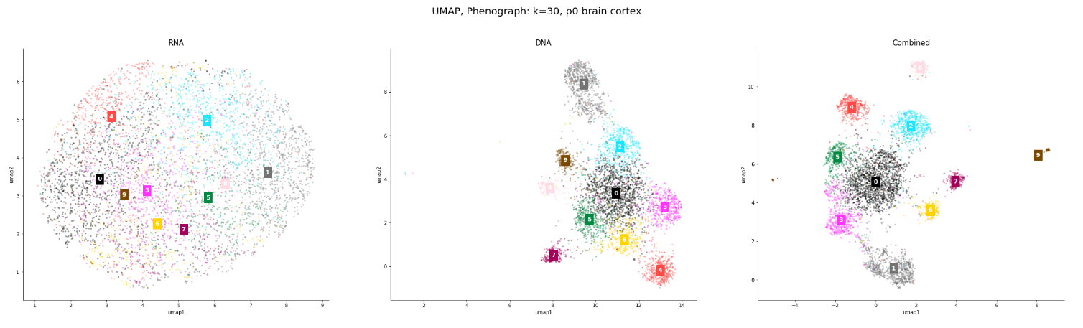
Phenograph

Slide 26
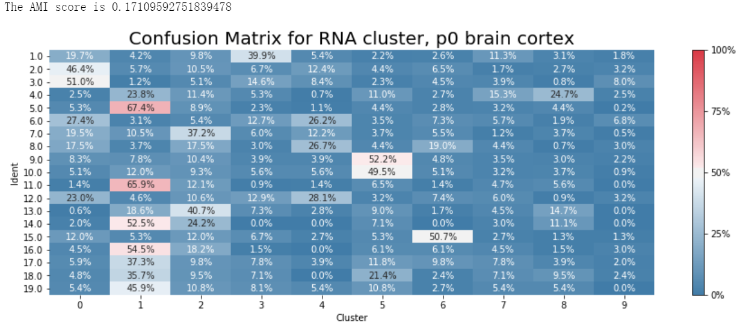

Slide 27
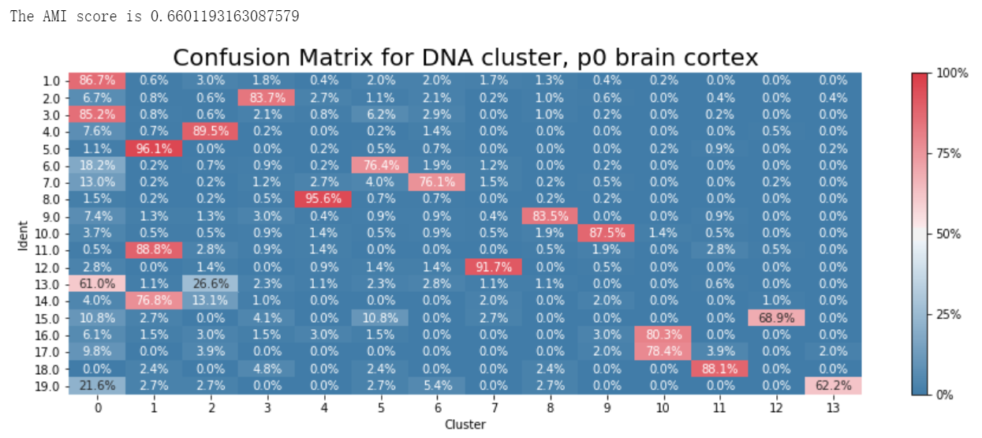

Slide 28
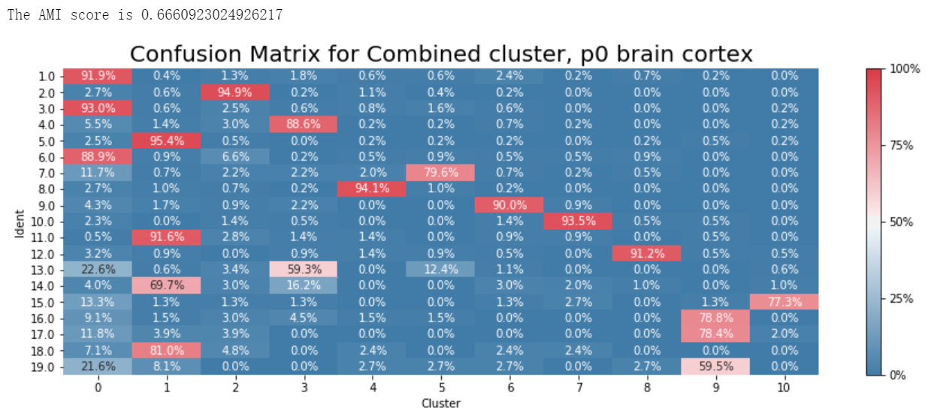

Slide 29
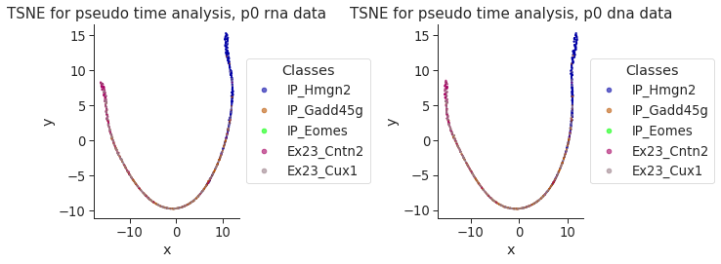
Pseudo-time Analysis

Slide 30
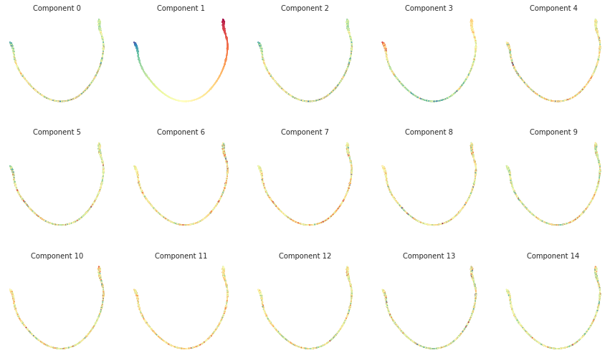
plot_diffusion_components rna

Slide 31
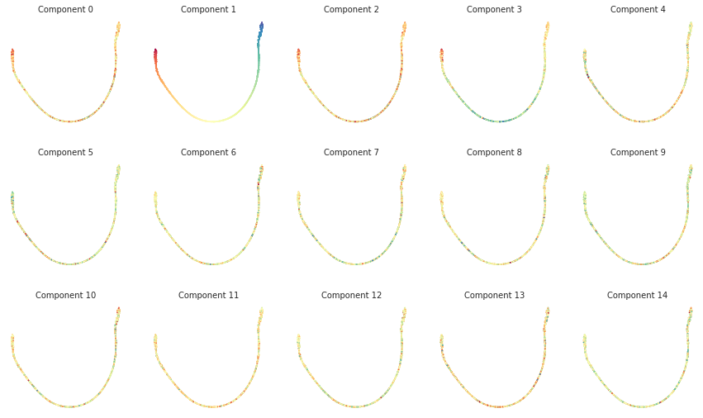
plot_diffusion_components dna

Slide 32
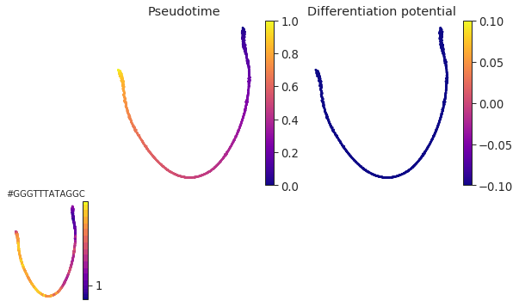
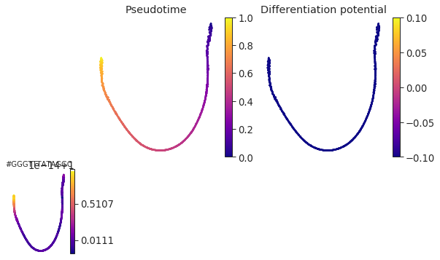
Palantir Result

